Slide 1
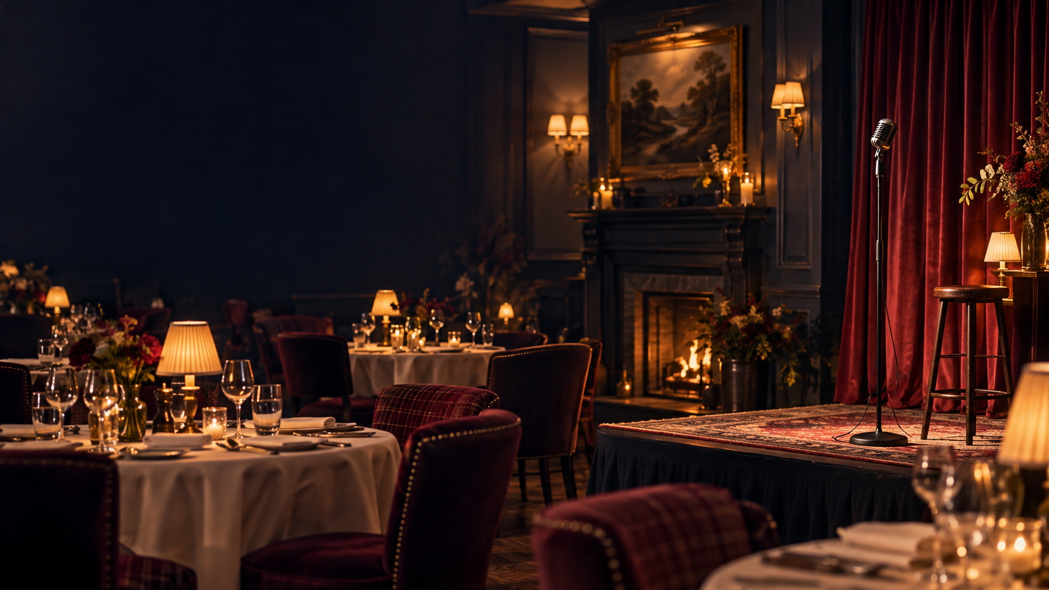
UNTAMED PRODUCTIONS
Dinner & Laughs
Live comedy designed for independent hotels
A complete 75–90 minute show from £350
South Wales launch | UK bookings
www.untamedproductions.co.uk
Notes:
Cover image generated for this proposal. It represents the intended atmosphere and does not depict a previous Untamed Productions event.

Slide 2
THE HOTEL OPPORTUNITY
A quieter evening can become an occasion
A comedy supper club gives local guests a reason to book dinner, stay for drinks and consider an overnight package.
RESTAURANT
More covers on a chosen date
BAR
The hotel keeps control of pricing, ticket sales, food and the guest relationship.
Extra dwell time and drinks sales
BEDROOMS
An easy overnight upgrade
Ideal for Thursday, Friday or Sunday evenings between major seasonal events.
UNTAMED PRODUCTIONS
02

Slide 3
THE GUEST EXPERIENCE
A relaxed evening with a clear rhythm
01
02
03
04
ARRIVE
DINE
LAUGH
STAY
Guests settle in and order drinks.
The hotel serves its chosen menu.
Two comedians deliver a hosted show with an interval.
Guests continue at the bar or upgrade to an overnight package.
The format works as a stand-alone local event or as part of a short-break package.
UNTAMED PRODUCTIONS
03

Slide 4
THE PACKAGE
One fee covers the complete comedy show
£350
Two comedians
One performer also hosts the evening and manages the room.
75–90 minutes
Two comedy sections with a natural interval for bar sales.
regional launch fee
Promotion supplied
Photographs, biographies, show copy and a personalised poster.
The hotel provides dinner for both performers and suitable overnight accommodation with breakfast.
Audience fit agreed
Warm adult comedy adapted to the hotel and its guests.
Travel outside the launch area and seasonal dates can be quoted separately.
UNTAMED PRODUCTIONS
04

Slide 5
ILLUSTRATIVE HOTEL MODEL
A 40-cover event can contribute about £588
40 guests × £39.95
Estimated food cost
£560
£1,598
Comedy performance fee
£350
ticket revenue
Promotion and ticketing allowance
£100
Indicative contribution
£588
Approximate break-even: 18 guests
Illustration assumes £14 food cost per guest and £100 event allowance. Normal staffing and overheads remain the hotel’s responsibility.
UNTAMED PRODUCTIONS
05

Slide 6
SHOW FORMAT AND TONE
Comedy that suits a hotel audience
A professionally hosted evening with enough structure for service teams and enough flexibility for the room.
7:00
7:30
8:45
9:00
9:25
9:45
Guests arrive
Dinner service
Host opens the show
First comedy section
Interval and bar service
Second comedy section
Content level is agreed in advance. The default is warm adult comedy suitable for a mixed leisure audience.
UNTAMED PRODUCTIONS
06

Slide 7
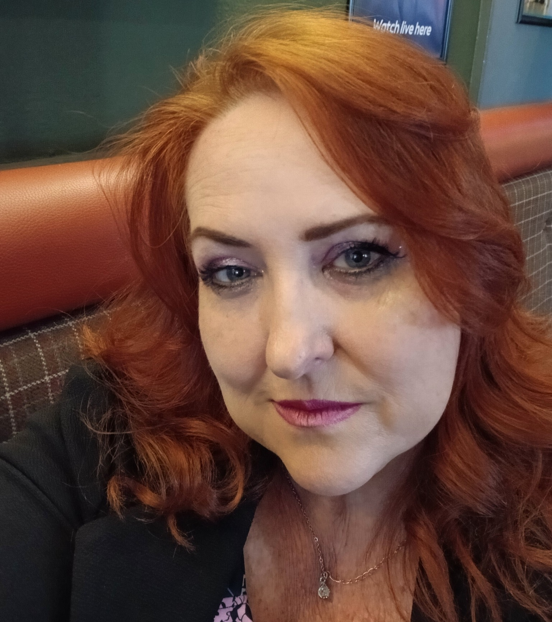
YOUR LEAD COMEDIAN
A proven professional-circuit act
AVA DA COSTA MAIA
South Wales comedian and experienced host
Ava’s warm, candid comedy explores modern dating, disability, family life and everyday absurdity. She has opened and closed weekend comedy nights and performed on professional lineups for the past year.
SELECTED CREDITS
Opened for Bennett Arron’s I Regret This Already
Supported Markus Birdman
Two Ray Turner Awards
One-hour showcase at RAM Comedy Festival
Swindon Comedy Festival
UNTAMED PRODUCTIONS
07
Notes:
Portrait supplied by Ava Da Costa Maia for use in this proposal.

Slide 8
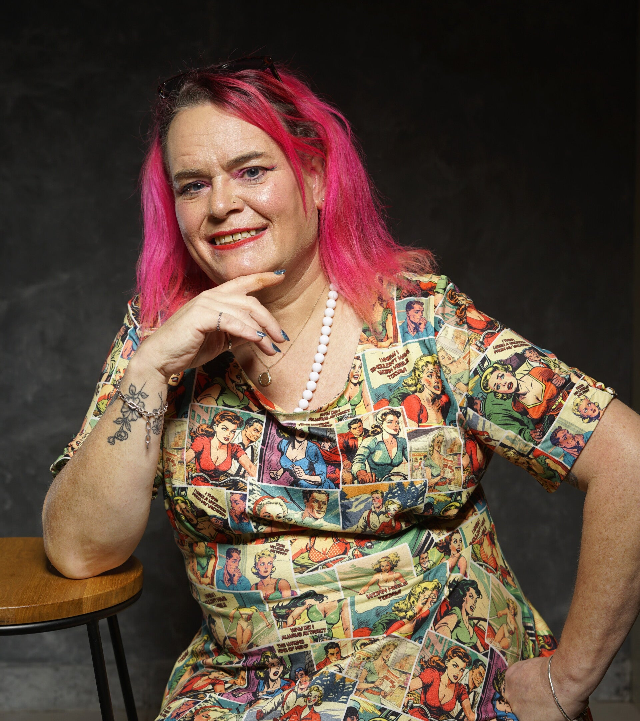
YOUR SECOND COMEDIAN
An experienced MC with a high gag rate
ABI MYLES
South Wales comedian and experienced MC
Abi performed more than 250 gigs in her first 18 months, including theatre shows, festivals, competitions and a one-hour show. She has hosted her own comedy nights and brings confident crowd work to the room.
SELECTED CREDITS
Beat the Frog semi-finalist, 2026
Queerovision semi-finalist, 2026
Derby New Comedian of the Year semi-finalist, 2026
Booked for The Comedy Store, Leicester Square
UNTAMED PRODUCTIONS
08
Notes:
Source: https://www.untamedproductions.co.uk/abi-myles, accessed 15 September 2026. Portrait sourced from the same page.

Slide 9
REVIEWS AND FOOTAGE
Praise from bookers and established acts
AVA DA COSTA MAIA
ABI MYLES
“INSTANTLY BOOKABLE”
“Charming, confronting, honest and endearing”
“Gold” and “a splendid performance”
Phil Nichol
Peter Fox, Notts Comedy Review
“A solid performer and hysterical”
“Terrific”
Bennett Arron
Kris Davies
“Every joke lands perfectly”
AVA FOOTAGE
Har Har Comedy
Watch Ava’s showreel
Watch selected set 01
Watch Abi live
Watch selected set 02
UNTAMED PRODUCTIONS
09
Notes:
Ava review source: https://nottscomedyreview.wordpress.com/2025/06/30/acts-that-have-impressed-me-the-most-june-2025/ . Additional Ava testimonials and the words ‘instantly bookable’ and ‘gold’ were supplied by Ava Da Costa Maia. Abi biography, reviews and video source: https://www.untamedproductions.co.uk/abi-myles, accessed 15 September 2026.

Slide 10
WHAT THE HOTEL PROVIDES
A straightforward partnership
ROOM
HOSPITALITY
A seated space with clear sightlines and a small performance area.
Dinner for two, breakfast and an accessible twin room or two rooms.
SOUND
OPERATIONS
A microphone, stand and suitable speaker system.
Normal service, bar, event staff and venue licences.
GUESTS
ACCESS
Ticketing, menu, table plan and customer communication.
Step-free access, nearby parking and agreed performer arrangements.
UNTAMED PRODUCTIONS
10

Slide 11
UNTAMED PRODUCTIONS
A comedy night your guests will remember
We are selecting hotel partners for pilot dates across South Wales and South West England.
Discuss a pilot date
£350
Ava Da Costa Maia | Untamed Productions
regional launch fee
www.untamedproductions.co.uk
Notes:
Add a direct business email address, telephone number and showreel link if desired before external circulation.

